Slide 1

SARASOTA POLICE DEPARTMENT
SARASOTA POLICE DEPARTMENT

Slide 2

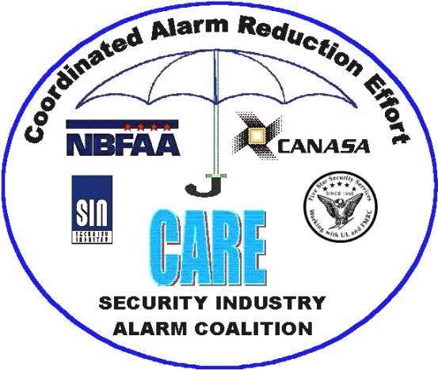
Alarm User Awareness Class

Slide 3
What We Will Cover
What is an alarm system and how do they work
What is a False Alarm
Causes & impacts of false alarms
How to reduce & eliminate false alarms
And more….
Notes:
In today’s presentation, I would like to accomplish several things.
Provide an understanding of why people install alarm systems.
Explain to you what an alarm system is and how they work - not to make you an expert, but just a quick “alarms 101” overview.
Answer the question - Do alarm systems really work?
Define and discuss the causes of false alarms and false dispatches.
Discuss false alarm reduction, statistics, the impact of false alarms and most importantly the industry’s effort to reduce and eliminate false alarms and false dispatches.

Slide 4
What Causes a Signal?
Open Door, Motion or Glass Break Causes Alarm
System
Sends
Message
Message Received
At Central Station or Monitoring Station
Notes:
65
Sensors are alarm system components like door and window contacts, Sensors detect opening,….. for example a door or window contact.
Motion - someone moving in an area or space.
Sound - like breaking glass.
Negative environmental change like temperature or flooding and of course smoke and fire.
Motion detectors, glass breakage detectors, etc..
Whatever the cause, an open door, evidence of motion, glass break, fire or holdup, an indication of a equipment or other problem, an alarm system will follow the same basic steps to communicate what is happening at the alarm site to the central station.

Slide 5
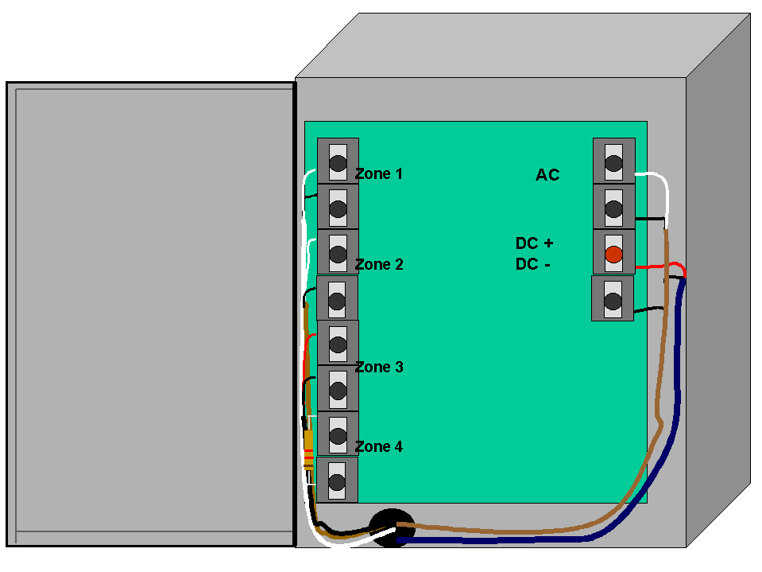
Control Panel
The “brain” of the system
Monitors the various sensors connected to it
Activates the siren sends signal over the phone line

Slide 6
Keypad
The user interface with the system
Allows the user to operate the system by pushing keys

Slide 7
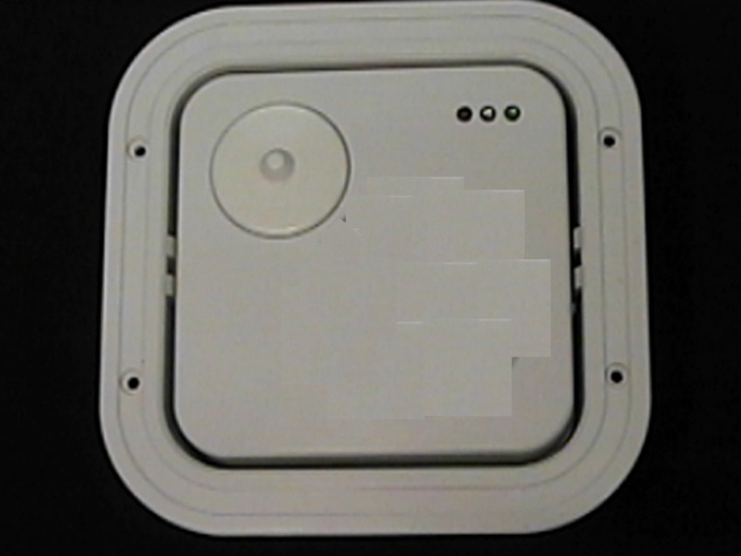
Glassbreak Detector
The “hearing aid” of the system
Detects sound of breaking glass

Slide 8
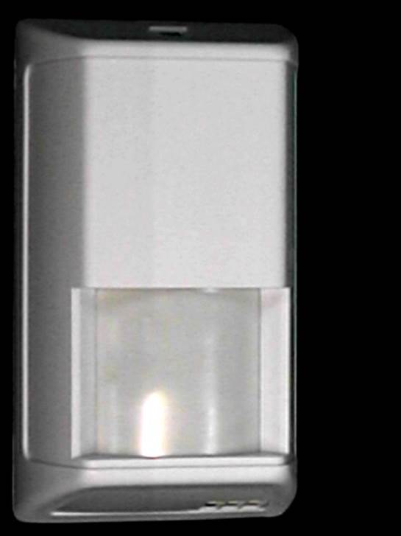
Motion Detectors
The inside “eyes” of the system
Detects motion on interior of premises

Slide 9
Contacts
The perimeter “ears” of the system
Located on doors & windows to detect opening or motion
Magnet

Slide 10
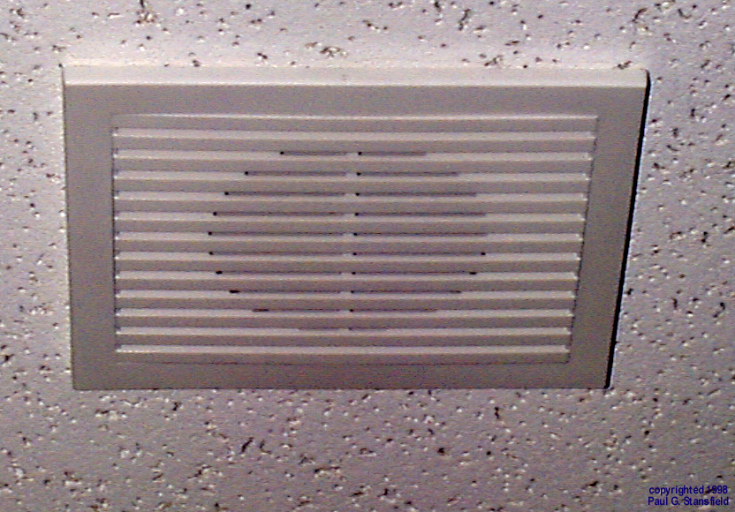
Siren/Speaker
The “voice” of the system
Sounds to frighten intruder & warn occupants

Slide 11


Alarm System- Disarmed
1
2
3
4
5
6
System is Disarmed- Off
7
8
9
*
0
#
Control
Panel
Siren is Silent
Battery
AC Power

Slide 12
Alarm System- Armed
1
2
3
System is Armed - On
4
5
6
7
8
9
*
0
#
Control
Panel
Siren Is Silent

Slide 13

Alarm System- In Alarm
System is Armed - On
1
2
3
4
5
6
7
8
9
*
0
#
Control
Panel
Siren Sounds
Operator is Notified

Slide 14

The Alarm Process
5
6
3
ALARM
COMPANY
CONTROL
PANEL
9
4
2
1
1. The alarm is tripped (e.g. door)
2. Signal is sent to control panel
3. Activates siren at premises
4. Seizes phone line - signal
is sent to alarm company
monitoring center
5. Alarm Co. calls premises to verify
6. Alarm is cancelled with password
or pass code, or
7. Alarm Co. calls Police
8. Dispatch
9. Alarm Co. calls emergency contacts provided by customer
7
8
POLICE
Notes:
Sensors Report
A master control unit - the brains of an alarm - system interprets signals from the sensors based on the nature of the emergency. It can notify all occupants of the home or business by noise or beeping.
Monitoring Center Notification
A monitored security system sends a signal by telephone line to the alarm dealers central station. Automation within the central station interprets the signal and directs the central station operator to the proper course of action.
Responding Authority Notification
This may include notification to the police, fire, medical or just owner notification for non-emergency events.

Slide 15
Alarms: Your First Line of Defense
“Used properly, alarm systems are one of the most effective ways to deter burglaries and break-ins.”
There’s just one problem...

Slide 16
What’s That Sound I Hear Next Door?
Could it be a false alarm?
False Alarm vs. False Dispatch
  False Alarm: Alarm system detects alarm status erroneously through user error, equipment, etc
  False Dispatch: Notification of an alarm to the law enforcement agency and responding authority finds no evidence of a criminal offense or attempted criminal offense
Notes:
What’s that sound next door?
It’s that dang alarm system going off at the neighbor’s home or business.
Could it be a false alarm?
What is a false alarm vs. a false dispatch.
There is a very definitive difference.

Slide 17
Alarms within this city
The City of Sarasota has approximately 3,300 residential and commercial alarm systems
In 2015 the number of new alarm systems is growing at the rate of 3% per year

Slide 18
False Alarms: The Problem
Sarasota Police Department receives an average of 5 false alarms a day, costing tax payers about $275,000 a year
Our goal is to minimize time wasted not helping the community and maximize officer time spent actually fighting crime, building relationships with citizens, and participating in crime prevention activities

Slide 19
False Alarms: The Problem
Alarm systems provide an effective deterrent to crime & serve as a first line of defense
against crime
BUT REPEATED FALSE ALARMS:
  waste law enforcement resources & taxpayer money
  could cause complacency in responding to alarms
  can result in no law enforcement response to an alarm

Slide 20
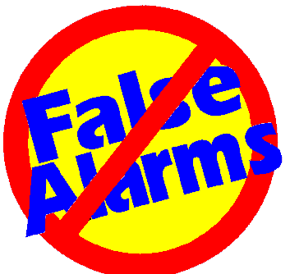
What Causes False Alarms?
In the past
Equipment Quality
Installation Quality
Misapplication of Equipment
Weather
User Inexperience
Today
User Error
Misapplication of Equipment
Installation Quality
Lack of required Maintenance
Notes:
What causes false alarms?
Today you probably never hear that loud siren next door like in the past. Times have changed and improvements in the alarm industry have been phenomenal. A while back when you heard the neighbor’s alarm system go off it probably was caused by a multitude of things.
And what are the primary causes of false alarms and dispatches today? Several years ago most were equipment caused, today most are user error, misapplication of equipment and sometimes, depending on the dealer, poor installation quality. Equipment failure with new systems, is a very small percent of false alarms.

Slide 21

Law Enforcement + Industry Involvement = Fewer False Dispatches
Government Regulation
  Ordinances
  Permitting
  Eliminating response to top offenders
Industry Self Regulation
  Equipment Standards & Improved Application
  Employee Training
  User Training
  Improved Monitoring Center Procedures
Notes:
How will the industry help eliminate false alarms in the future?
Industry self regulation is just as important as our cooperative national programs and state and local government regulations. The alarm industry has developed and updates regularly:
Equipment standards and application
Installer training and servicing.
More complete, recurring and simplified user training.
Improved monitoring center procedures like alarm verification before dispatch and operator training programs.

Slide 22
Which False Alarm Problems Do We Fix First?
National Study of False Alarms- SIA-STAT- 1994

Slide 23
What can YOU do to Reduce False Dispatches
Understand how your system works
Lock & secure all doors & windows
Know cancellation code
Respond to activated alarm to meet officers
Notes:
Make sure a responsible party is available to meet law enforcement officers when the alarm has been activated.

Slide 24
What can YOU do to Reduce False Dispatches
Call your alarm company and contact our Alarm Unit:
  BEFORE you start any remodeling
  When you add or change a new authorized alarm user or emergency contact
  When you change your phone number
  When you add a pet to your home
  When you are moving
  When you have an unexplained false alarm
Notes:
Keep your responsible party list that you provide to your monitoring service up to date.
Call the central station and inform them of any remodeling, repair, electrical, telephone line work that is going to be done at the premises.
Advise your alarm company of any telephone number change at home or work. Telephone numbers for your responsible parties should be checked for any changes.
If you change anything at the premises, please call your alarm company.
Make sure everyone is out of the building or residence before arming the system.

Slide 25
What can YOU do to Reduce False Dispatches
Train ALL alarm users
  Everyone who has a key needs to know how to use your system
  Includes housekeepers, guests, realtors, neighbors, relatives, etc. Anyone who may stay at your home while you are not there
Notes:
Make sure everyone who has access (this also means keys) to the premises knows how to operate (turn the alarm on and off) the alarm system and knows how to clear a false alarm with the monitoring company. This includes baby-sitters, maids, Realtors, relatives, teachers, janitors, etc.
Be sure that telephone repairmen, electricians, carpenters and other repairmen or servicemen are aware and careful of the alarm system.
Every person who uses the system should know their password or identification code for verification with the central station.

Slide 26
What can YOU do to Reduce False Dispatches
Re-Entering
If you re-enter your premises because you've forgotten something, turn off the alarm & re-set it when you leave again.
Do this even if you think it will only be a few seconds!

Slide 27
What can YOU do to Reduce False Dispatches
Canceling Alarms
If you accidentally set off an alarm make sure all phones are on the hook and wait for your alarm company to call you back, OR
Follow your alarm company's instructions for canceling an alarm signal

Slide 28
What can YOU do to Reduce False Dispatches
Bypassing Zones
Know how to "bypass"(shut off) the motion detector when you are at home
Know how to shut off a malfunctioning component ("zone") until repair is completed

Slide 29
What can YOU do to Reduce False Dispatches
Inspect The Alarm System
Follow your alarm company's instructions on testing the system regularly - don't test it by intentionally setting it off
Have your alarm company replace batteries as needed wireless systems generally require this more often
Get a yearly systems inspection
Notes:
Is the alarm panel transformer plugged into a 24-hour outlet? The alarm system must have AC power. NEVER unplug the transformer, you may forget to plug it back in. If your power must be off for more than 10 hours, please call your alarm company.
What shape is the battery in? The battery’s life depends on how often power outages occur and how many accessories the system is driving (i.e., keypads, motion detectors, smoke detectors, etc.) Most panels will send a low battery signal to the central station when the battery’s voltage lowers to a certain level.
Low batteries are the most common equipment reason for false alarm activations.

Slide 30
What can YOU do to Reduce False Dispatches
Holdup Buttons
Seriously consider whether you truly need this option
Properly train your employees
Make sure you do not have "single action" holdup buttons

Slide 31
What can YOU do to Reduce False Dispatches
Duress Codes
A duress code appears to turn off the system but sends a special emergency message to your monitoring center, for example, if you were forced to turn off the system against your will

Slide 32
What can YOU do to Reduce False Dispatches
Keypad Entry Errors
Know how to "clear" a wrong code if you make a mistake on the keypad
Some keypads only require that you eventually get the right numbers in sequence

Slide 33
What can YOU do to Reduce False Dispatches
Door & Window Alarms
Doors & windows must be tight fitting & locked
Door & window contacts must be free of paint & varnish
Make sure there is no door or window warping
Check weathering of security screens
Notes:
Be sure the door or window is completely closed and locked. If an unlocked door is opened by a person, wind, dog, etc., the alarm is activated and law enforcement respond, it is considered a false alarm.
What to watch for in doors:
Unsecured magnets
Warping of the top of the door
A metal or metal sheathed door should have a larger or stronger magnet
Closed but not latched and locked doors (especially your delay doors)
An increased gap between door and jamb due to settling of house
For double doors - make sure fixed side is pinned on top and bottom
Shaking a door should not set off the alarm
What to watch for in windows:
Unsecured magnets
Windows should be completely closed and locked - it may show a good circuit at the time of arming, but a misaligned magnet and contact may false alarm with a change in temperature or humidity
Casement windows that are cranked closed against the closed latch with the latch not securing the window
Mini blinds attracted to the magnet
Unplugged alarm screens
Tears or excessive patches on window foil

Slide 34
What can YOU do to Reduce False Dispatches
Motion Detector Alarms
Be aware of what can cause motion detector alarms -
    helium balloons (especially Mylar)
    pets
    bugs on the lens
    curtains
Notes:
A motion detector should not be aimed directly toward an air vent or fireplace
Caution should be used in placing plants in field of view of motion detector
Mylar balloons are a common cause of false alarms
If pets are in your premises while the interior motion(s) is/are on, be sure the detector and lens are designed to provide a pet alley. If you acquire a pet, please contact your alarm company.
Spiders or bugs may form webs around the detector or may actually get inside the case. Keep the face of the detector clean.
Drafts in the walls can cause false alarms if the motion detector is flush mount
Movement of vertical blinds can cause false alarms
Christmas and Holiday decorations cause false alarms
Motion detectors need a clear view - do not block them. Do not stack things around the line of view, as they may fall over
Ceiling fans cause air movement - this can cause false alarms
The area around smoke detectors, motion sensors or other interior devices should be inspected for dust, webs and insects. Interior cleaning of these devices must be done by your alarm company

Slide 35
The Alarm Ordinance
Each alarm system must be registered with the Police Department
A False Alarm is now defined as:
  Law enforcement dispatched to the site, when no evidence of a criminal act can be found
  In other words, there is either a burglary or a false alarm – no gray area

Slide 36
The Alarm Ordinance
Permit Fees:
Residential $ 35
Renewal (annual) $ 35
Commercial $ 35
Renewal (annual) $ 35

Slide 37
The Alarm Ordinance
One "Free" false alarm per year
Schedule of fines for false alarms:
  2 - 4 Offenses $ 50 each
  5 - 6 Offenses $ 100 each
  7 - 8 Offenses $ 250 each
  9 + Offenses $ 500 each

Slide 38
The Alarm Ordinance
Failure of an alarm user to make payment for penalties or fees for “excessive false alarms” (3 or more false alarms in one permit year), within 30 days of billing date will result in
Discontinuance of Law Enforcement
to respond to alarm signals at premises until payment is received

Slide 39
The Alarm Ordinance
A Civil Penalty of $100 may be levied against an Alarm User for any violation of the ordinance (including failure to register)
Penalty can be waived if user registers (registration form and waiver request is mailed out with notice of penalty)

Slide 40
The Alarm Ordinance
The penalty can also be waived if user attends an Alarm User Awareness Class presented by the Police Department approximately four times per calendar year
A certificate for a successfully completing Alarm User Awareness Class will eliminate one single alarm fee or one Civil Penalty, not to exceed $100

Slide 41
What To Expect From Your Alarm Company
Provide written instruction manual
Provide clear training at the time of installation
Available to answer follow-up questions prompt & effective repair of the system
Alarm verification by telephone call, video or audio built into your system

Slide 42
What To Expect From Your Alarm Company
Proper licenses
Available to update account information - phone numbers, emergency contacts
Able to identify "zones" which have been tripped
Available to receive calls and perform repairs after normal business hours
Inform alarm owners that according to our ordinance 15-5118 they have to register within 15 days of installation of their alarm system

Slide 43
Measure Your Company’s IQ
The Installation Quality Certification Program is an industry certification program which identifies companies that exceed standards in the areas of:
    IQ User Training Guidelines
    IQ Employee Training Guidelines
    IQ System Design Guidelines
    IQ Equipment Guidelines
    IQ Installation Guidelines
    IQ Monitoring Guidelines
Ask your company if they are IQ Certified!

Slide 44
ALARMS CAN BE YOUR FIRST LINE OF DEFENSE
Now you know...
But…
You have a responsibility to use your system properly
And…
Now you know how!!!

Slide 45
For More Information!
SPD Alarm Unit 941-954-7054
or
CSAA - Central Station Alarm Association
SIA - Security Industry Association
SIAC – Security Industry Alarm Coalition
Other State & Local Alarm Organizations

Slide 46




Contact Information
For more information, feel free to contact:
The Security Industry Alarm Coalition
(972) 377-9401 or stan@siacinc.org
The National Burglar & Fire Alarm Association
(301) 585-1855 or fact@alarm.org
The Installation Quality Certification Board
(301) 585-1855 or iq@alarm.org
The False Alarm Reduction Association
(301) 279-1917
Notes:
The National Burglar & Fire Alarm Association (NBFAA) is an association of installing & monitoring alarm dealers that provides: seminars, training, guides, user brochures & lists of qualified dealers
The False Alarm Reduction Association is an association of government-employed alarm ordinance managers, most of whom work for local law enforcement agencies.

Slide 47
Copyright & Acknowledgements
This presentation was created by the NBFAA False Alarm Prevention Committee and is © 1998 National Burglar & Fire Alarm Association (NBFAA).
NBFAA grants permission to use this presentation in conjunction with any Alarm User Awareness School.
NBFAA gives permission to modify this presentation only in order to make it applicable to a locality’s ordinance specifics so long as the NBFAA copyright is left intact on all slides.
NBFAA is grateful for the input of FARA & Brink’s Home Security during the development of this presentation.

